Slide 1


Simple, Shared Ways
to Show the Difference We Make
ACE Conference 29 May 2026
A practical Tūhono Impact workshop for adult and community education providers
80 minutes | light-touch evidence | provider-facing

Slide 2

Dr Rosie Gallen
80 minutes | light-touch evidence | provider-facing

Slide 3
The promise of the session
“Start small. Use what you already have. Add one thing only if it helps.”
Not extra admin
Not one-size-fits-all
Not a reporting machine
We begin with the reality of busy providers.
Local context stays visible. Shared ground does not flatten difference.
Evidence should help providers learn and tell their story.
Today is about useful, manageable evidence, not performative paperwork.
ACE Conference 2026

Slide 4
How the 80 minutes will move
10m
10m
10m
25m
15m
Frame the challenge
What providers told us
Three shared signs
Try the worksheet
Share back and next steps
The rhythm moves from listening → shared language → practical action.
The session tests what feels useful and realistic. It does not ask providers to adopt a finished model.
ACE Conference 2026

Slide 5
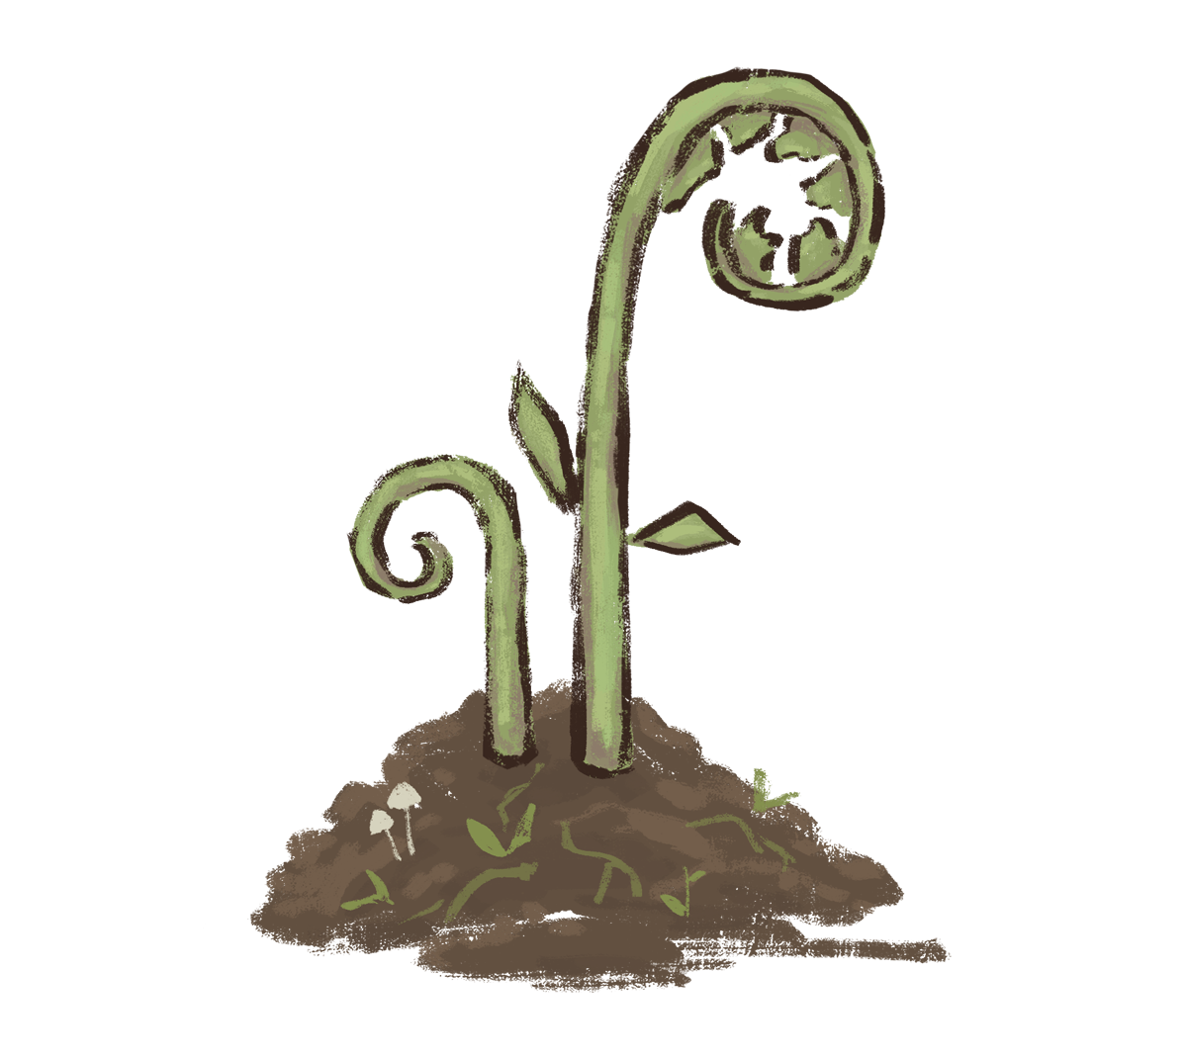
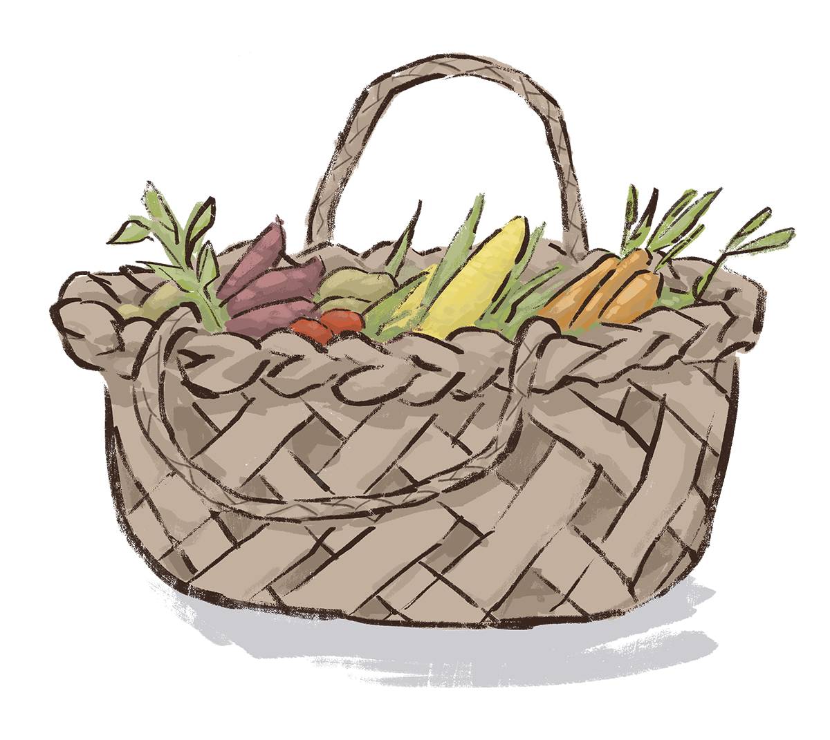
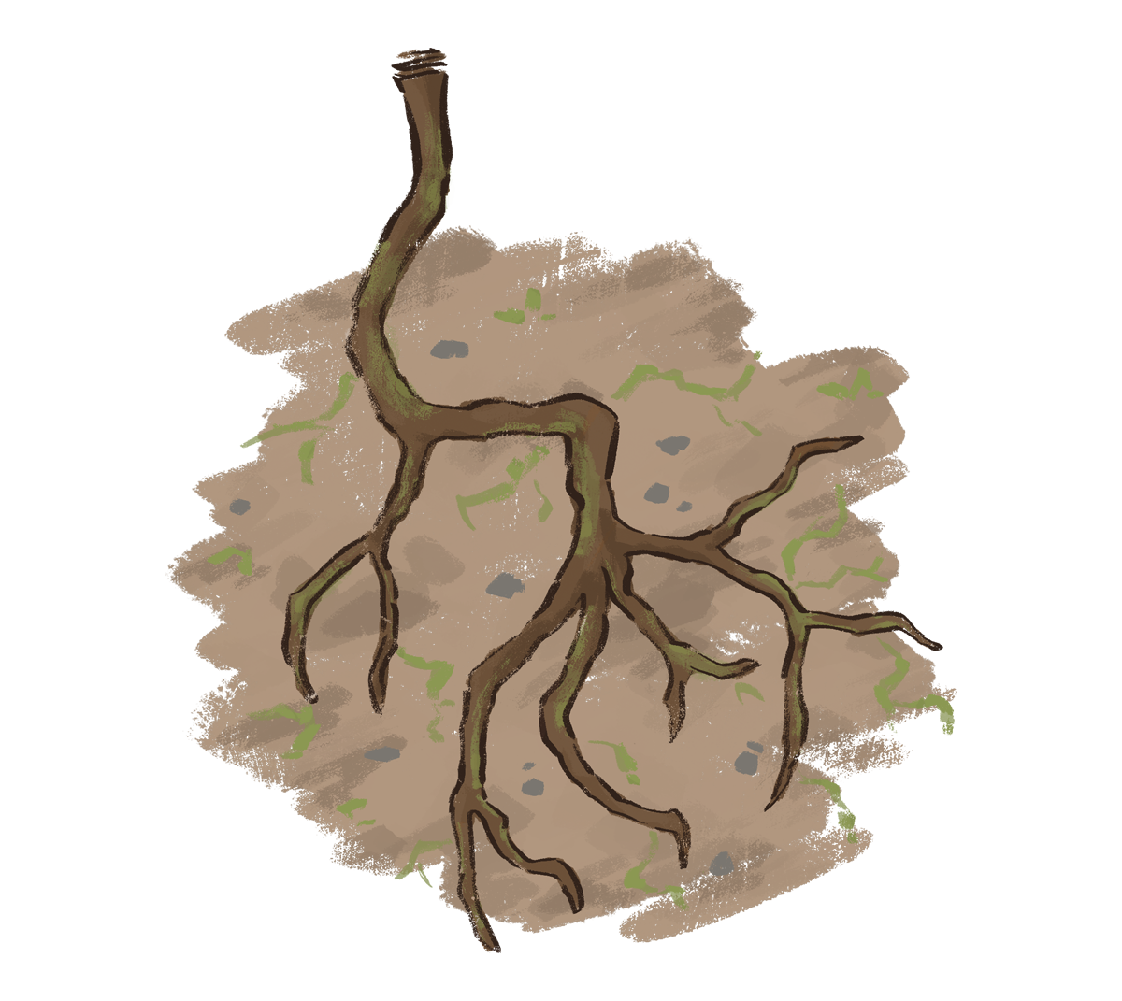
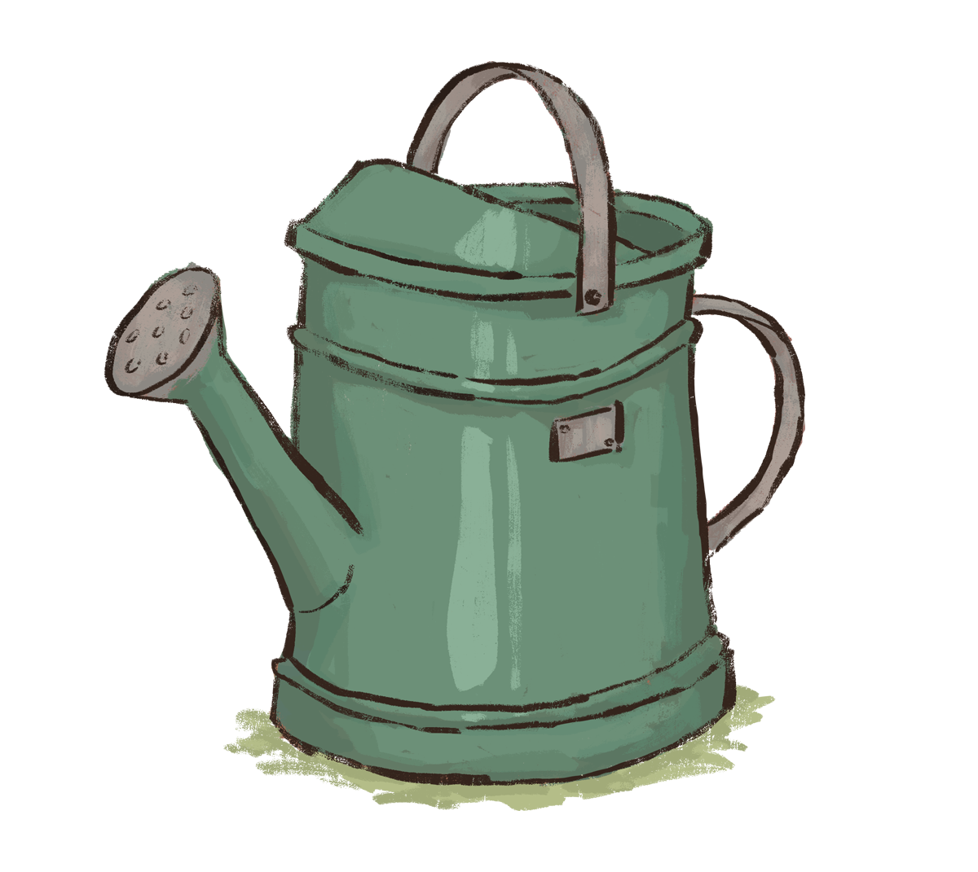
He Mara Mahi Tahi
- our shared garden architecture and the five elements
Ngā Kākano/ Seedlings – Purpose
Te Kete Hauhake/
Harvest Basket
– Impact and Sharing
Ngā Pakiaka/ Roots
- What Your Good Looks Like
Puoto/Watering Can
– Learning and Adapting
Rā Putiputi/ Sunflowers
– How We Notice and Measure Change

Slide 6
Step 1
Ngā Kākano | Clarifying purpose
What change occurs because this mahi exists?
Purpose statement
We exist to strengthen whānau confidence, connection, and access to support so that families feel less alone and more able to navigate challenges early.
Notes:
“We did not begin with measures. We began with why the mahi exists.”

Slide 7
Step 2
Ngā Pakiaka | What YOUR good looks like
“We know our mahi is working when…”
How do you define your success?
Learners feel more confident in taking the next step
Learners feel more connected in the group
Learners complete the course

Slide 8
Step 3
Rā Putiputi | Mixed evidence
What change do you notice?
Number of whānau returning after first contact
Percentage reporting greater confidence asking for help
Number of learners taking practical next steps
Stories showing progress and increased skill
What matters here
A small set, not an exhausting list
Numbers and narratives together
Evidence linked back to what good looks like
Low-burden (meaning easy to collect).
Notes:
“This is mixed evidence with a purpose, not data collection for sport.”

Slide 9
Step 4
Te Puoto | Learning and adapting
Learning rhythm
Monthly team check-in
Quarterly review of patterns and stories
Ask: what are we noticing, what is shifting, what needs to change?
Evidence is used for decisions, not just reporting
Learning changes practice.
Notes:
“If the evidence does not change practice, it is just admin with a lanyard.”

Slide 10
Step 5
Te Kete Hauhake | Communication and Sharing
Example: One-page impact snapshot
Board reporting
Funder conversation
Staff reflection
Why this format
Proportionate
Credible
Quick to read
Able to hold both evidence and meaning
Key principle
The snapshot shows both measurement and meaning

Slide 11
PULSE CHECK SNAPSHOT
What providers told us
Small sample, strong steer
The pulse check points to a practical starting point, not a sector-wide verdict.
Connection / less isolation
8
Clear message
Confidence
6
Providers value connection, confidence and participation, but want any shared approach to stay simple, flexible and low-burden.
Skills or knowledge
5
Personal goal
5
Participation / keep coming
4
Meaningful next step
4
ACE Conference 2026

Slide 12
Start where meaning and manageability overlap
What matters
What is manageable
Useful shared practice
Connection
Confidence
Personal progress
+
Attendance
Short feedback
Tutor observation
→
small • clear • doable
A shared approach works only if it honours both sides.
ACE Conference 2026

Slide 13
Tūhono Impact
Five practical questions
2
4
1
3
5
What change are we hoping to see?
What do we already have?
What matters most?
What do we already notice?
How could we use this learning?
The framework is the quiet spine, not the spotlight.
ACE Conference 2026

Slide 14
Three shared signs to test
1
2
3
Connection
Confidence
Participation
Learners feel more connected / less isolated
Learners grow in confidence
Learners take part and keep coming
welcomed • peer support • less alone
speak up • ask • try • take a next step
attend • stay involved • continue
These are a starting point, not a decree.
ACE Conference 2026

Slide 15
Shared sign 1: Connection
Learners feel more connected and less isolated.
feel welcomed
build relationships
support each other
return because they belong
What you might hear
What you might notice
“I’ve met people here.”
“I don’t feel so alone.”
“I look forward to this group.”
Learners talk more easily, help each other, or stay after the session to connect.
ACE Conference 2026

Slide 16
Shared sign 2: Confidence
Learners feel more able to speak, ask, try and take a next step.
Before
During
After
→
→
quiet, unsure, watching
asks a question, joins in
tries something new
A learner saying “I can do this now” may be small in words and large in consequence.
ACE Conference 2026

Slide 17
Shared sign 3: Taking part and keeping coming
Learners attend, stay involved and continue participating as much as they can.
“Keep coming” is about ongoing participation in the current learning opportunity, not only returning for a new one.
What this helps show
Retention, engagement and what helps people stay involved.
Week 1
Week 2
Week 3
Week 4
Week 5
Week 6
ACE Conference 2026

Slide 18
Tiny evidence lanterns, not a stadium lighting rig
Evidence can be counted, noticed, heard or shown.
Counted
Noticed
Heard
Shown
attendance
enrolment
participation patterns
tutor observation
peer support
confidence shifts
learner quote
one check-out question
informal comment
photo
learner work
reflection wall
Pick one method that fits your setting. Keep it only if it helps.
ACE Conference 2026

Slide 19
A simple method menu
Attendance pattern
One check-out question
Tutor observation note
Learner quote
Before / after card
Photo or work sample
Group reflection wall
Follow-up text or email
The invitation: one change, one method, one next step.
ACE Conference 2026

Slide 20
Worksheet: start where you are
1
What activity are you thinking about?
2
What change matters most?
3
What would you see, hear or notice?
4
What do you already have?
5
What simple method could you try?
This is not a paperwork exercise. It is a way to turn everyday knowledge into a clearer story.
ACE Conference 2026

Slide 21
Activity: test it against reality
In pairs or small groups, choose one real learning activity and work through the worksheet.
1
The change that matters most
Listen for the friction
2
One thing we already notice
What feels realistic? What feels too much? Both answers matter.
3
One thing we already have
4
One simple method we could try
5
One thing that would make this hard
ACE Conference 2026

Slide 22
Share-back: what should ACE Aotearoa take forward?
Useful
Realistic
Too hard
Support needed
•
•
•
•
•
•
•
•
•
•
•
•
The feedback is part of the evidence. It tells ACE what will actually work.
ACE Conference 2026

Slide 23
What happens next
Test
Adapt
Share
Work with a small group of providers to try the shared signs and worksheet.
Refine language and methods based on what providers say is useful.
Build a simple companion guide and examples that others can use.
The next phase should grow from practice, not from a desk.
ACE Conference 2026

Slide 24
Start small.
Use what you already have.
Make it useful.
Show what matters in ways that fit the reality of your work.
Thank you
Tūhono Impact Companion Guide for ACE Providers

Slide 25
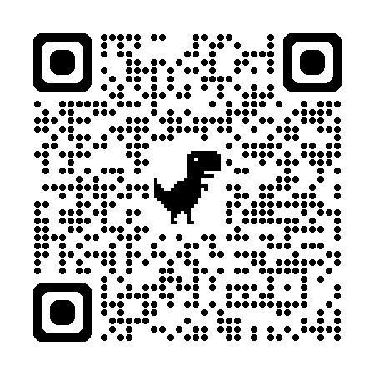
www.Tuhonoimpact.nz
Scan for handout, slides and your companion guide

